Slide 1
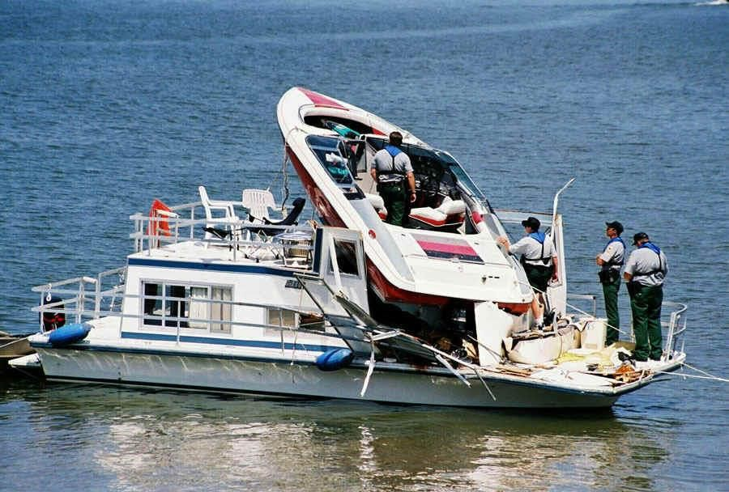
Recreational Boat Crash Analysis For the USA

Slide 2
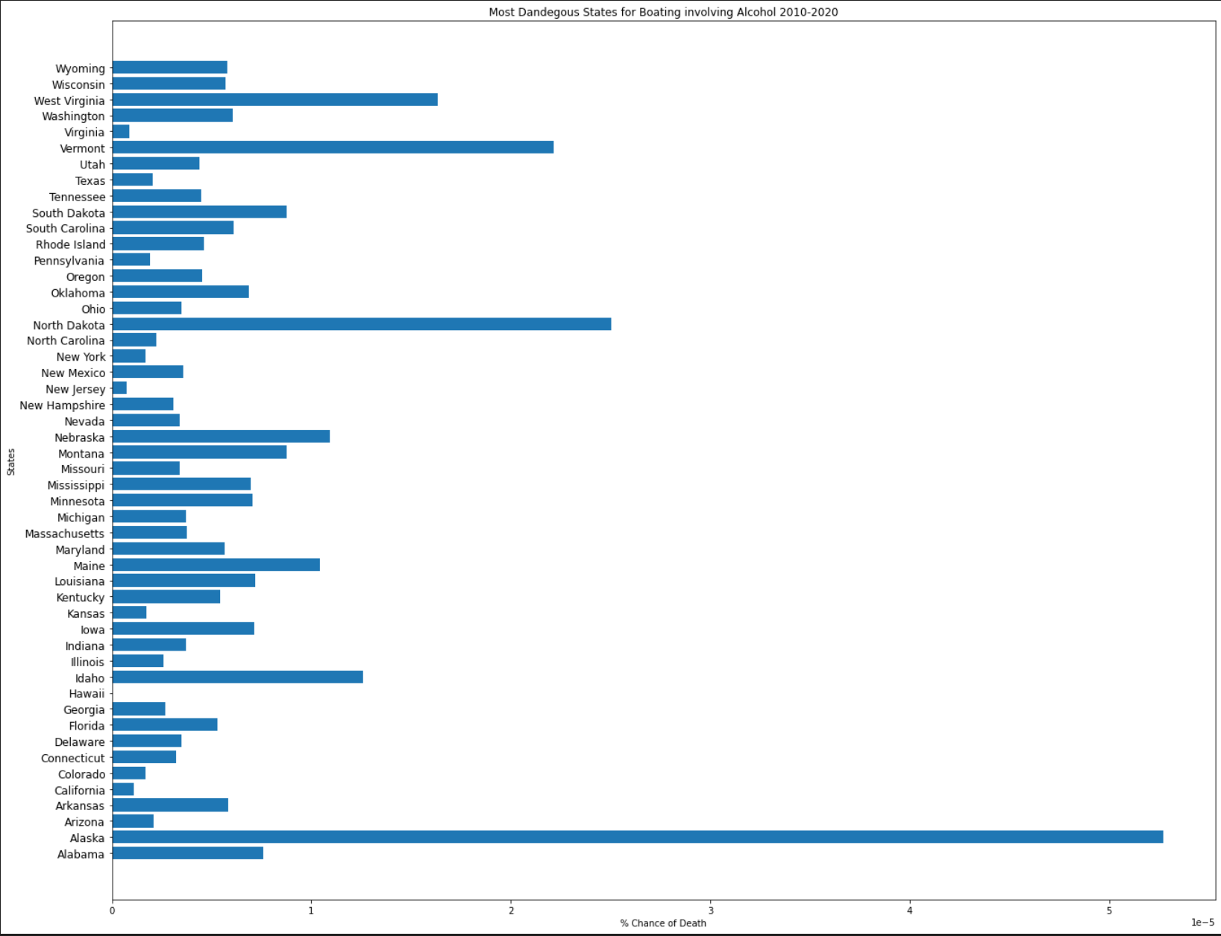
Most Fatalities Per State Involving Alcohol Per Average Population

Slide 3
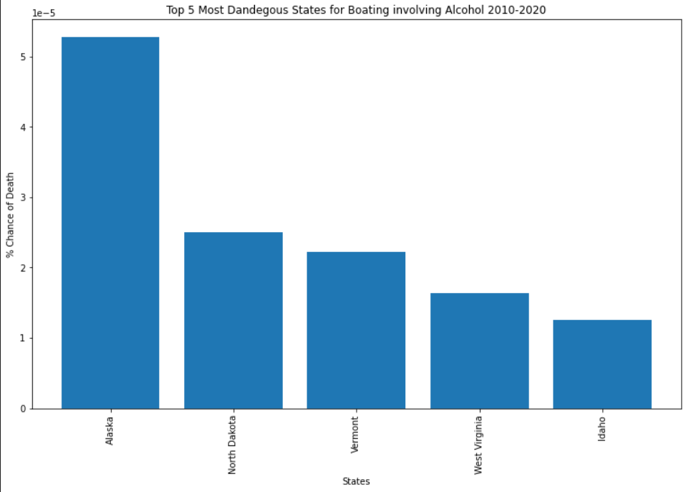
Most Fatalities Per State Involving Alcohol Per Average Population Top 5 States

Slide 4
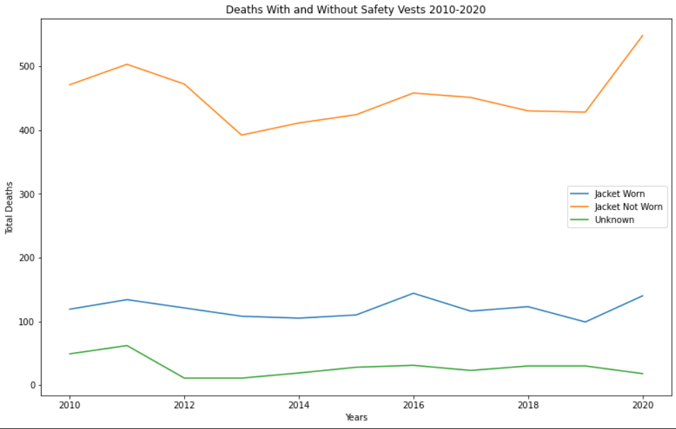
Fatalities Involving whether Safety Vests were worn between 2010-2020

Slide 5
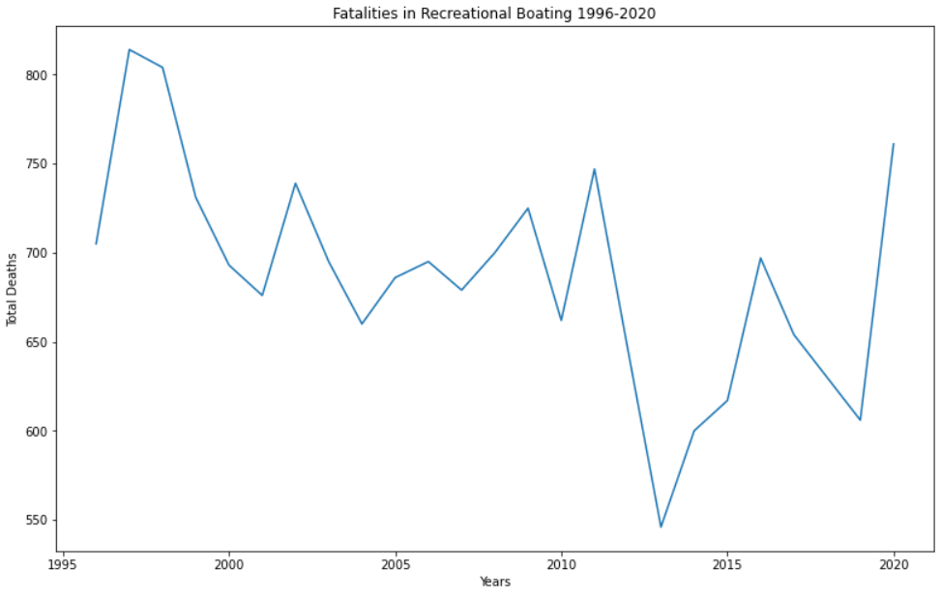
Fatalities in Recreational Boating 1996-2020

Slide 6
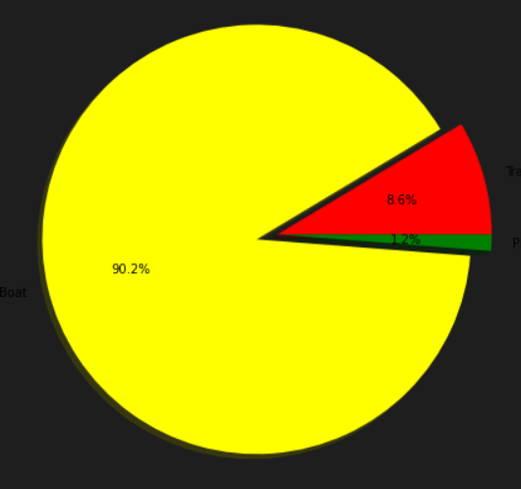
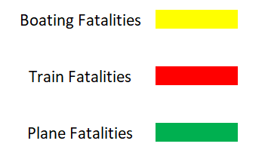
Comparing Total Boating, Train and Plane Fatalities between 2010-2020

Slide 7
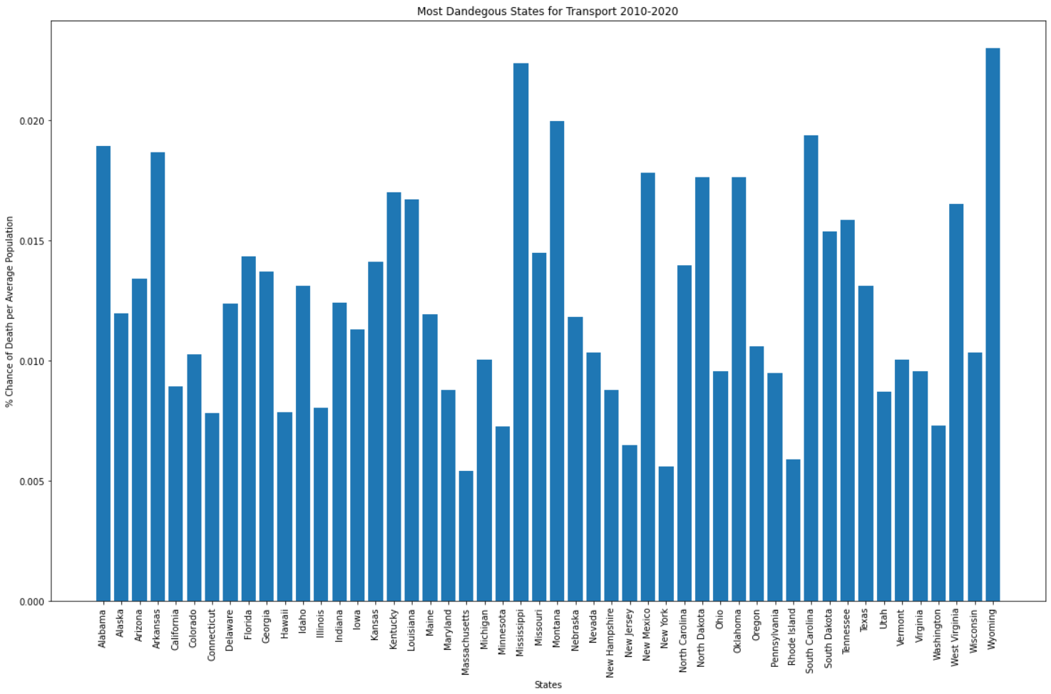
Most Dangerous States for Transport by Average Population 1996-2020

Slide 8
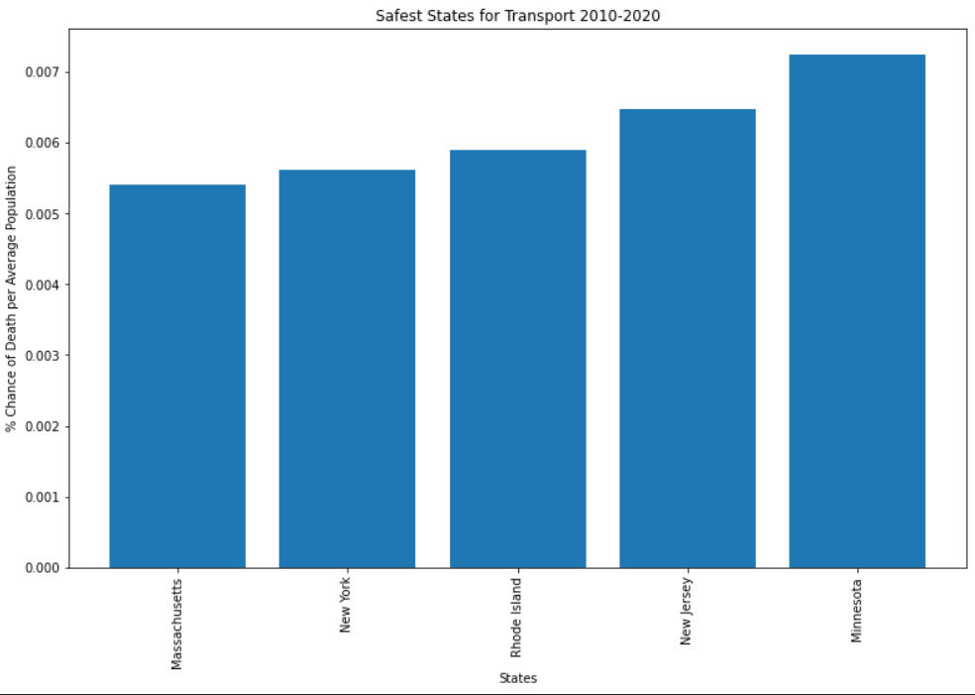
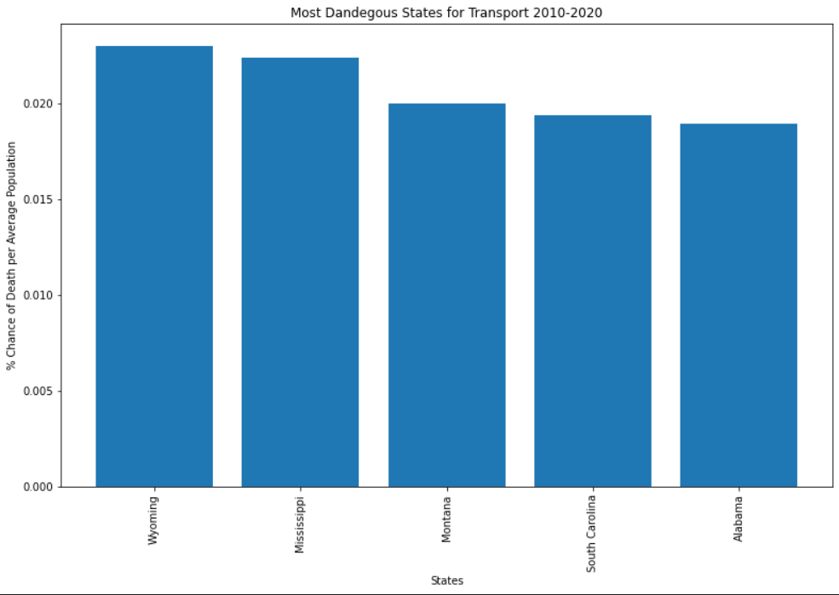
Top 5 Safest & Most Dangerous States for Transport by Average Population

Slide 9
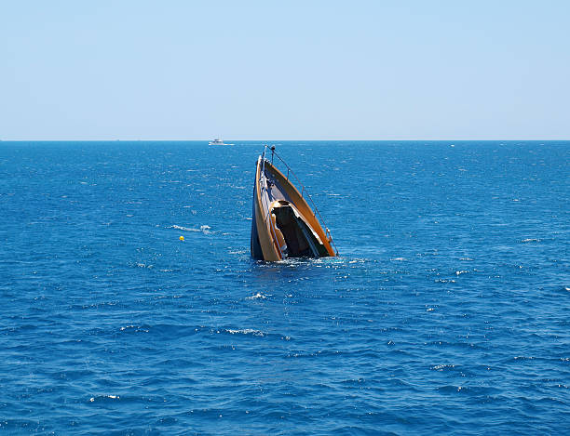
The End

